Slide 1
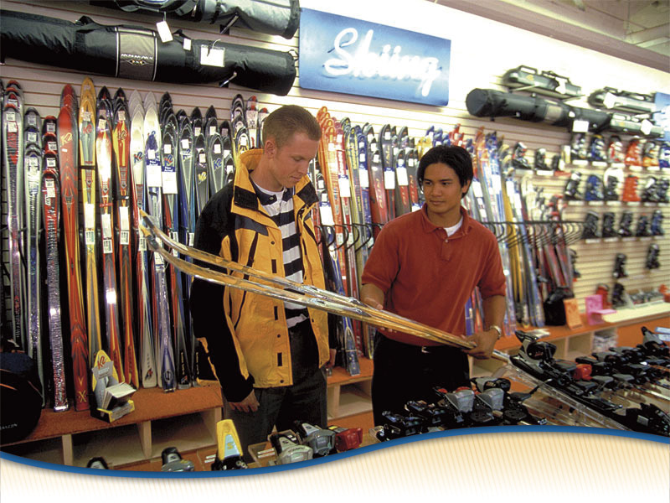
What Is Selling?
Chapter 13
Initiating the Sale
  Section 13.1 The Sales Process
  Section 13.2 Determining Needs in Sales

Slide 2
What Is Selling?
  Objectives
  List the seven steps of a sale
  Explain the importance and purposes of the approach in the sales process
  Demonstrate how business-to-business sales representatives conduct the initial approach
  Name three methods for making the initial approach in retail sales
Marketing Essentials Chapter 13, Section 13.1

Slide 3
Put the Terms in order of steps
Go to Google Classroom – Open Group Activity
Each student attempts this but can be discussed with a partner – put in order what you think is the proper order
Presenting the product: Educate the customer about the product’s features and benefits
Continual Relationship building: Create a means of maintaining contact with the customer after the sale is done
Closing the sale: Get customer’s agreement to buy
Overcoming objections: Learn why the customer is reluctant to buy and providing information to remove that uncertainty
Approaching the customer: Greet the customer face-to-face
Suggestion selling: Suggest additional merchandise that will save customer money or enjoy the original purchase
Determining needs: Ask questions to learn what the customer wants/needs

Slide 4
The Selling Process
Selling process of matching customer needs and wants to the features and benefits of a product or service
Seven key steps to helping a customer decide on a purchase:
  Approaching the customer: Greet the customer face-to-face
  Determining needs: ask questions to understand what the customer is looking for
  Presenting the product: Educate the customer about the product’s benefits (features converted to a selling point)
  Overcoming objections: Learn why the customer is reluctant to buy and providing information to remove that uncertainty

Slide 5
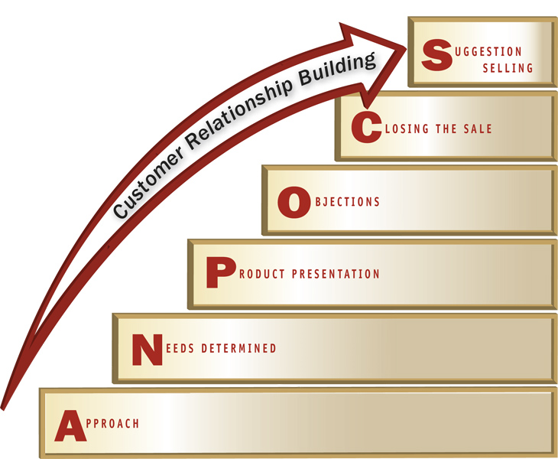
The Selling Process
  Closing the sale: Get customer’s agreement to buy
  Suggestion selling: Suggest additional merchandise that will save customer money or enjoy the original purchase
  ex: Best Buy- after laptop purchase you can get a printer for ½ off
  7. Continual Relationship building: Create a means of maintaining contact with the customer after the sale is done
Marketing Essentials Chapter 13, Section 13.1

Slide 6
Two Types of Customers in Selling
B2B (Business to Business and Retail Selling:
B2B selling is different than Retail Selling (Consumers)

Slide 7
1. Approaching the Customer
Initial Impressions are lasting:
  Salespeople can make or break a sale in the first few minutes
  Initial approach is critical and has three purposes:
    Begin a conversation
    Establish a relationship with the customer
    Focus on the product

Slide 8

Why I am not a good Salesman

Slide 9
GREET THE CUSTOMER
When greeting a customer, use GNAP.
  Purpose: GNAP is an acronym on how to properly introduce yourself. It’s practiced with a smile and a handshake.
  G – greeting - Hi, or Hello
  N – name - what is your name
  A – affiliation - what company/group do you represent
  P – purpose – why are you here/calling

Slide 10
Good morning. Welcome to the Magi Market, my name is Carrie. Is there something I can help you find?

Slide 11
GNAP Examples
Can be used in any situation and in selling!
“Hi, I’m Carrie. I am a junior at Minot High School and am here to pick up an application.”
“Hi, my name is Carrie. I’m a member of the Minot High softball team. I’m here to drop off these flyers for Randy Wilson.”
“Hello, my name is Carrie. I work with Minot High School. I’m looking to print a small catalog and am wondering who I would speak with about a price estimate.”

Slide 12
You Try
Call to Request a meeting:
  You are part of DECA. You are calling Jones Photography to sell them a one month ad space in the Minot High Window Display Case. Write your introductory statement to request an appointment.
Arrival at the Meeting:
  You are part of DECA. You have been asked to sell the window display space to local businesses. You have already set up an appointment with James Jones at Jones photography. Write your greeting in the space provided in your note packet.

Slide 13
End of Hour

Slide 14
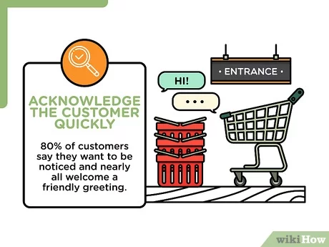

Slide 15
The Approach in Business-to-Business Selling
    Begin a conversation
      Conducts research prior to meeting – what products you may have to meet their needs
      Salesperson sets up an appointment
      Arrive early to will show your customer you are interested
      Smile and introduce yourself and your company (GNAP)
      Use the customer’s name. You can also give a business card
    Establish a relationship with the customer
      Existing Customers - recollections about the customer’s family, interests, or hobbies
      Comment on recent happenings in industry, or comments on what you see in their business
    Focus on the product
      What are the features that will build desire and interest in the customer. Convert these to how they will benefit the customer

Slide 16
Approach in Retail Selling
    Begin a conversation
      be alert to customer’s interests
      Observe the customer’s behavior in the store
      Greet the customer - good morning/afternoon/evening
    Establish a relationship with the customer
      Treat customer as an individual – use eye contact and show genuine friendliness
      Don’t stereotype based on age, sex, race, appearance
      Be enthusiastic, respectful, and maintain eye contact
    Focus on the product
      What are the features that will build desire and interest in the customer. Convert these to how they will benefit the customer
Marketing Essentials Chapter 13, Section 13.1

Slide 17
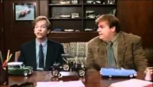
The Bad Salesman

Slide 18
The Approach in Retail Selling
Three approach methods used for retail customers:
  The service approach
  The greeting approach
  The merchandise approach
Evaluate the selling situation and the type of customer to determine which method is best
Marketing Essentials Chapter 13, Section 13.1

Slide 19
Greeting the Customer

Slide 20
Service Approach
service approach X, A way to approach a customer that focuses on asking the customer if he or she needs assistance.
Used an open-ended question such as “Good morning, how can I help you?”
Customer can say “yes” or “no.”
No means they want to be left alone or time to show around
Marketing Essentials Chapter 13, Section 13.1

Slide 21
Greeting approach
greeting approach X a way to approach a customer that focuses on welcoming the customer to the store
salesperson simply welcomes the customer to the store
Simply Saying “Good morning”
  customer knows salesperson is available for assistance
  Important to smile and be friendly
  Use a rising tone of voice - falling tone sounds unfriendly
Marketing Essentials Chapter 13, Section 13.1

Slide 22
Merchandise Approach
merchandise approach X, the salesperson makes a comment or asks questions about a product in which the customer shows interest
Start talking about product without asking if need assistance
Give the BENEFITS (of features) about product that is not apparent to the eye
Ex: That is an excellent camera as it is great for taking high action photos in any lighting conditions. In addition it has a full 3 year warranty.
  Method used if a customer stops to look at a specific item
  usually the most effective initial approach in retail sales because it immediately focuses attention on the product

